Slide 1
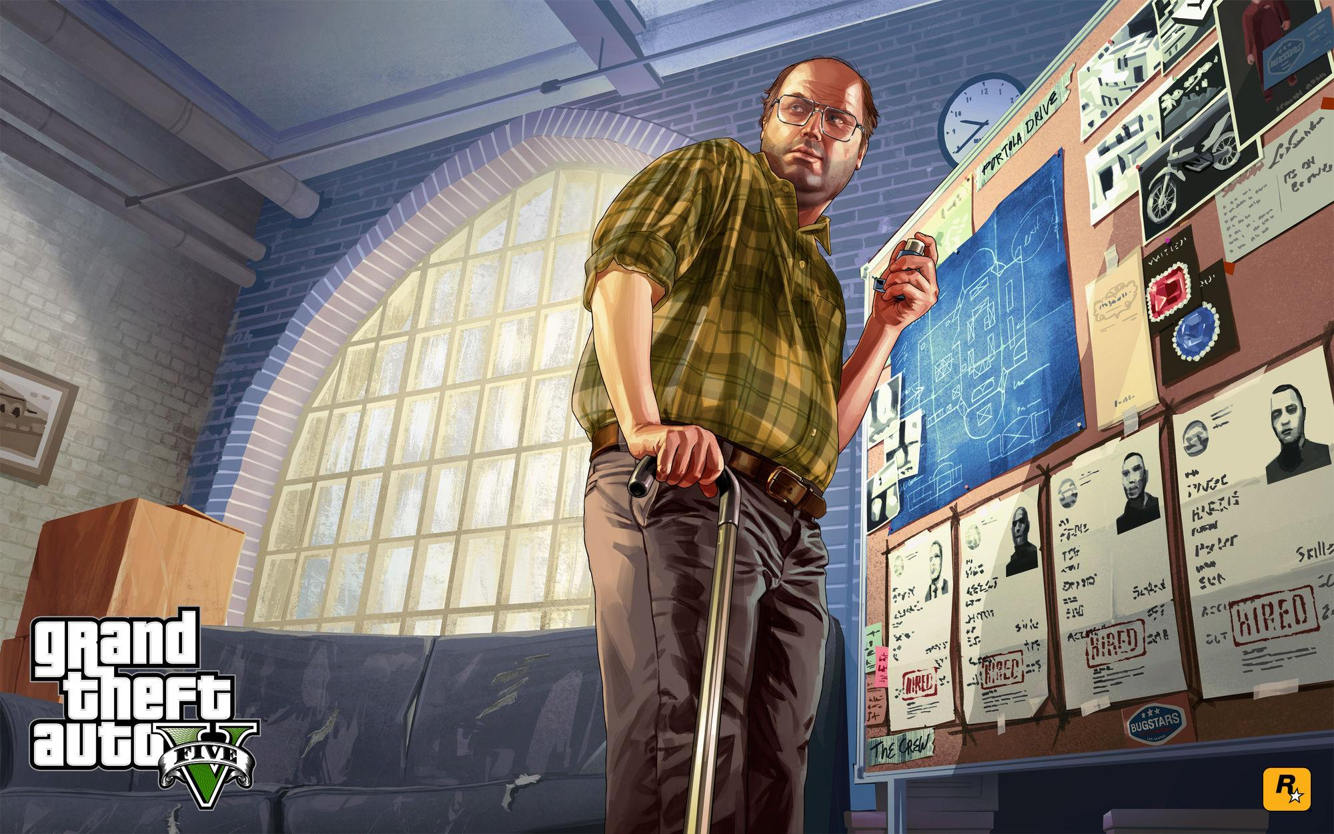
Gaming and Representation
Sexuality and Ability

Slide 2
Poor Representation is at least Representation
By now you’ve heard me rant and rave about representation in gaming based on race and gender.
And you’re probably thinking “but where are all the differently abled and LGBT video game characters, Rob.”
Exactly! No matter how poorly women and minorities are portrayed in modern games, at least they exist.
But what if you’re LGBT, deaf, blind, in a wheelchair, or suffering from Autism or some such affliction?
Where is your representation? The answer? Hard to find.

Slide 3
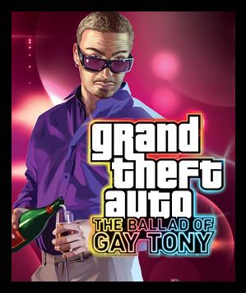
Regarding LGBT characters
Virtually invisible in all forms of entertainment media.
When they are portrayed, gay men often used for comic effect or with exaggerated femininity.
Have a read of Wikipedia’s fabulous page discussing LGBT characters in VGs: https://en.wikipedia.org/wiki/LGBT_characters_in_video_games
It’s a long list of stereotypes and characters used for comic relief or deviance (with some instances of genuine progressiveness thrown in).

Slide 4
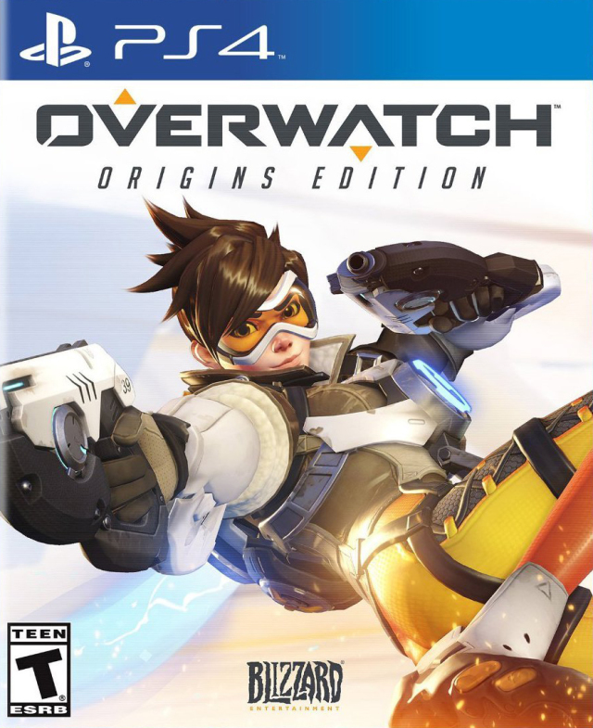
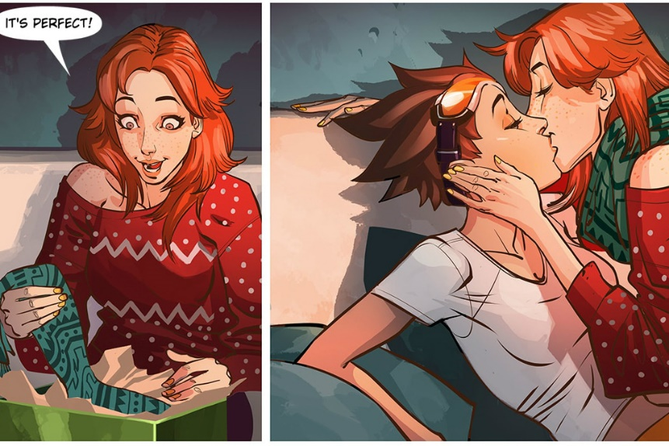
Tracer in Overwatch
Arguably the first mainstream LGBT video game character in a triple A title.
Her ‘coming out’ in her comic was as much anticipated and celebrated as Ellen’s on her own TV show many years ago.
And yet, the sad thing is that what should be a common occurrence—the visibility of LGBT characters in games—IS a big deal at all: why don’t more designers include more LGBT characters in games?

Slide 5
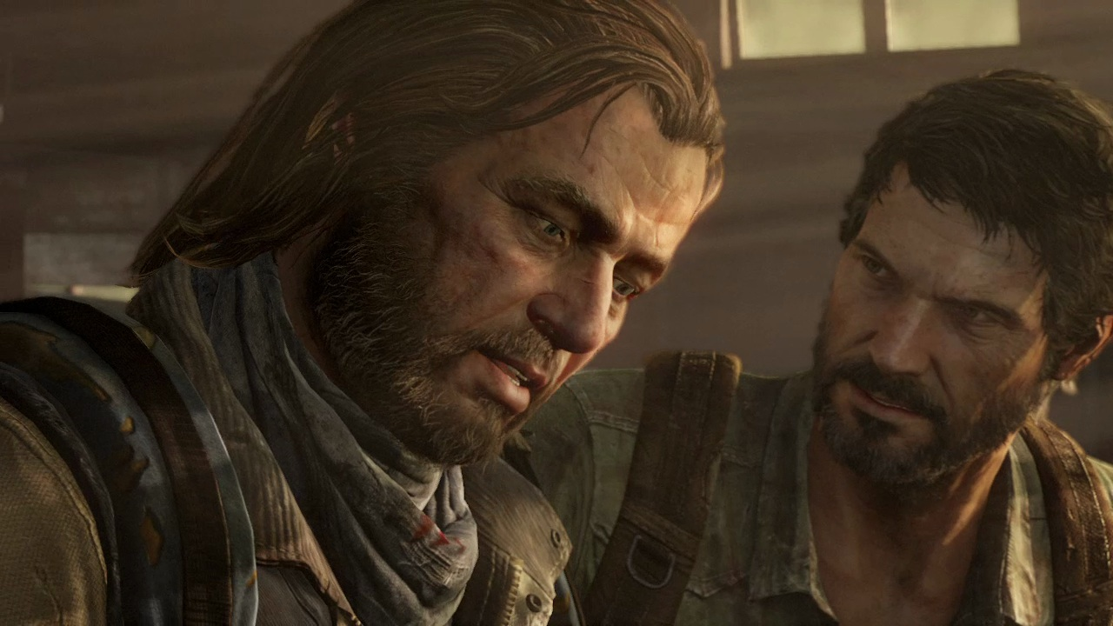
Bill from The Last of Us: one of the only examples of a non-stereotypical gay character in a video game. Great voice work. Complex character. But he’s an NPC.

Slide 6
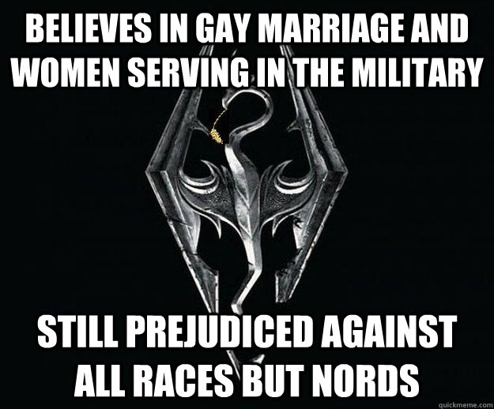
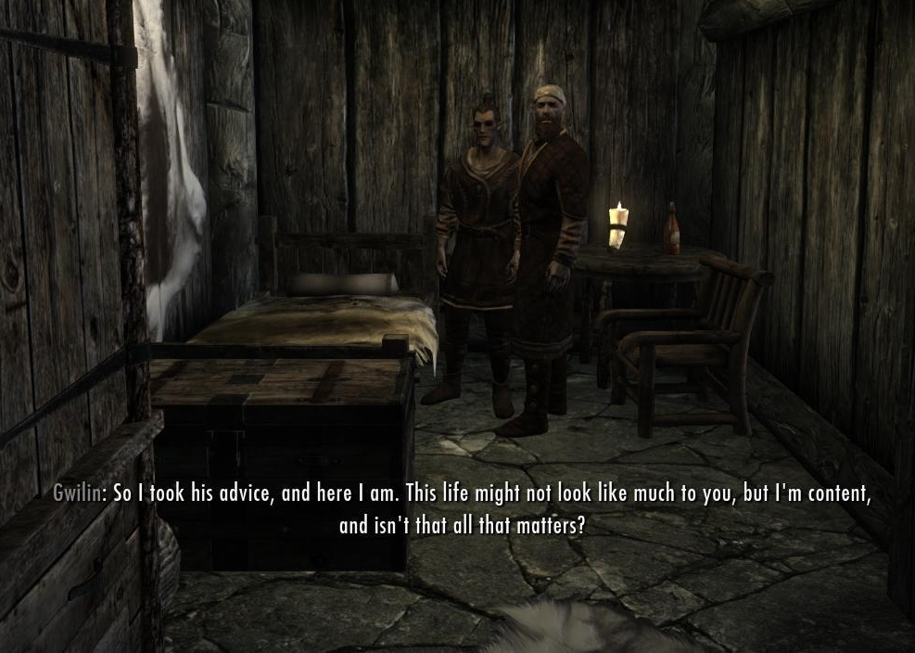
Same Sex Romance/ Marriage in VGs?
In 1998 Interplay releases Fallout 2, featuring the first same-sex marriage in a game
2004's Fable allowed the player character to flirt, marry and/or have sex with NPC townspeople of the same sex.
Skyrim does the same in 2011
2007 Mass Effect features same sex (female only) romance plots; 2012 ME3 allows male/male relationships.

Slide 7
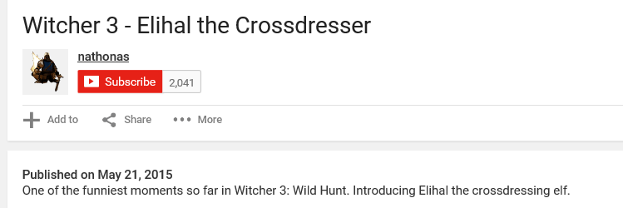
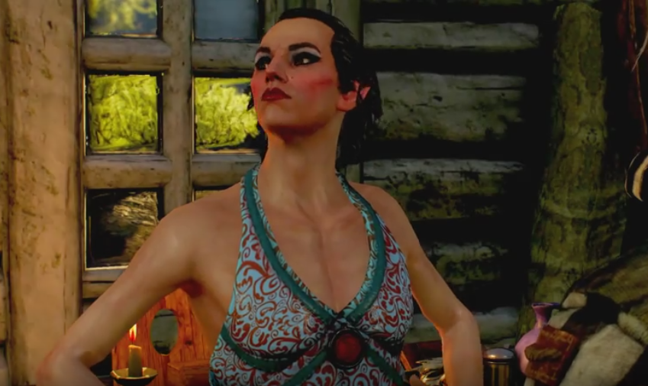

Elihal the Crossdresseng Elf in Witcher 3: used again for comic relief (and the internet crowd agrees!). Not cool.

Slide 8
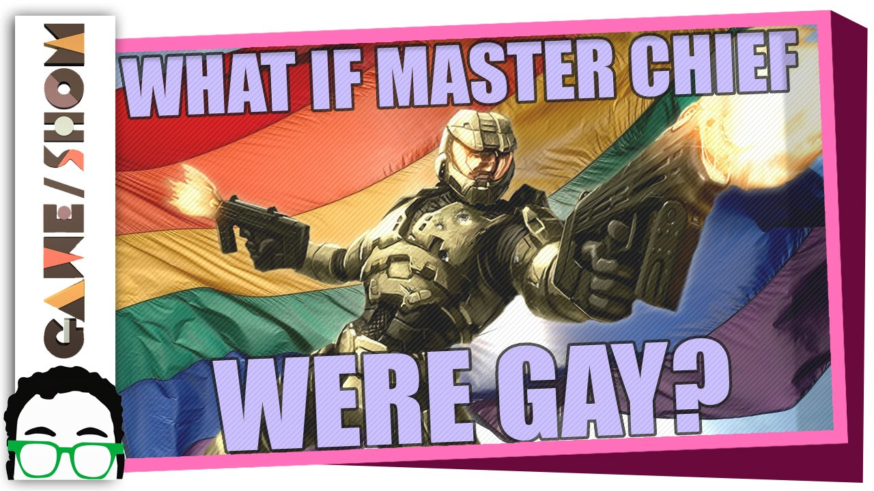
It seems (as usual) having a complex character and/or lead protagonist in a game who just so happens to be LGBT is too much for video games. Oh well…maybe in 20 or 30 years Vgs will catch up to society.
Excellent video exploring the issue. Please watch!
Would it Matter if Master Chief Were Gay? | Game/Show | PBS - YouTube

Slide 9
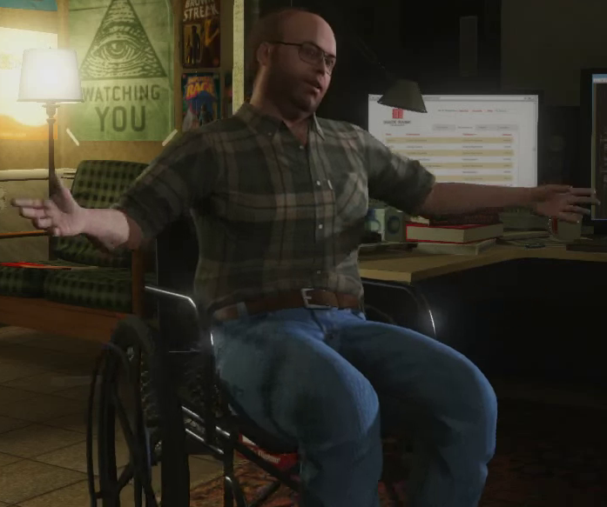
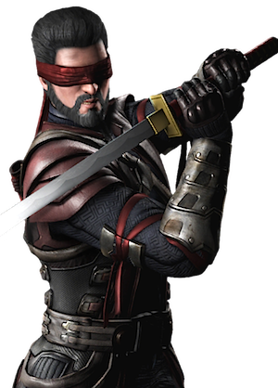
What About Ability?
15% of the WORLD suffers from some type of disability.
Again, virtually invisible in video games, and when depicted, often shown as pitiful, weak, or deviant characters. Or their disability is the defining trait of their character (see next slide).
Lester in GTA V has a puffer, uses a wheelchair and cane. He’s actually very likable and smart, and his disability is never once mentioned: but still, he’s only an NPC.
Deaf Characters? One rumoured to appear in the Half-Life universe at some point
Blind characters? Kenshi from Mortal Kombat, Rahm Kota from Star Wars: TFU—that’s about it.

Slide 10
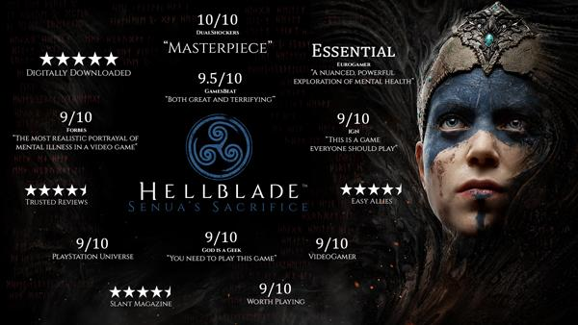
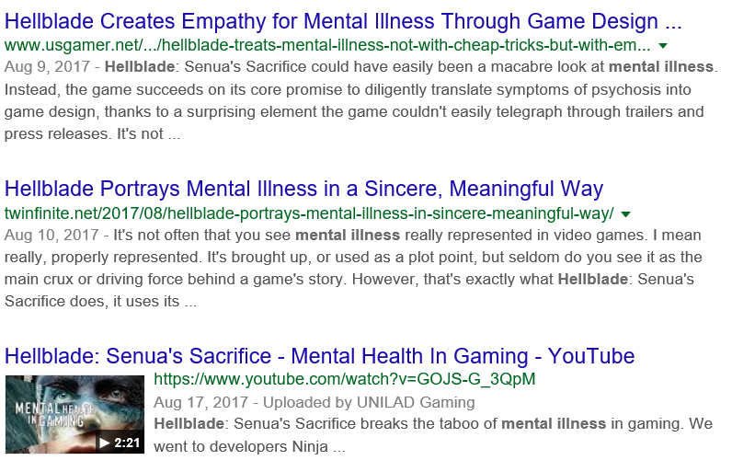
Hellblade: Senua's Sacrifice
In game worlds rife with novelty ‘sanity meters,’ Hellblade took the bold step of engaging with mental illness and making it part of its gaming mechanics.
Created in collaboration with neuroscientists and people who experience psychosis to present mental illness with accuracy and empathy.
Actually won the ‘Games For Impact’ award at the 2017 Games Awards.

